Slide 1


Dan
1/11/2024

Slide 2

Outline
Executive Summary
Introduction
Methodology
Results
Conclusion
Appendix

Slide 3
Executive Summary
Summary of methodologies
Data collection
Data wrangling
EDA with data visualization
EDA with SQL
Building an interactive map with Folium
Building a dashboard with Plotly Dash
Predictive analysis
Summary of all results
EDA results
Interactive analytics
Predictive analytics

Slide 4
Introduction
Project background and context
SpaceX is launching its rockets at a lower cost than its competition. This is due to SpaceX reusing its first stage rockets.
Problems you want to find answers
Predicting if the first stage of the SpaceX Falcon 9 Rocket will land successfully

Slide 5

Section 1

Slide 6
Methodology
Executive Summary
Data collection methodology:
SpaceX Rest API
Web Scrapping from Wikipedia
Perform data wrangling
Cleansing nulls and irrelevant columns
Perform exploratory data analysis (EDA) using visualization and SQL
Perform interactive visual analytics using Folium and Plotly Dash
Perform predictive analysis using classification models
LR, KNN, SVM, DT models have been built and evaluated for the best classifier

Slide 7
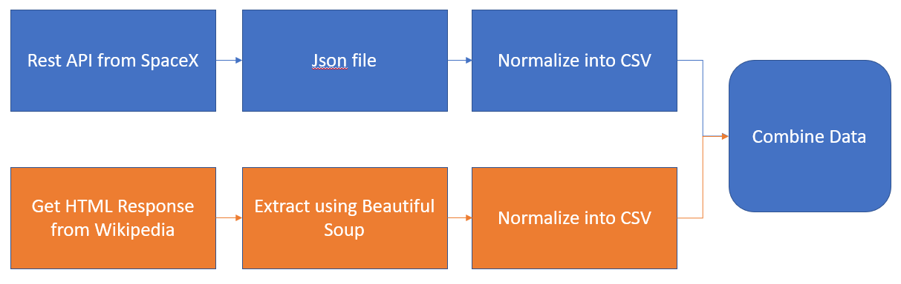
Data Collection
Launch data is retrieved from SpaceX API
Other supplementary launch data is retrieved from Wikipedia

Slide 8
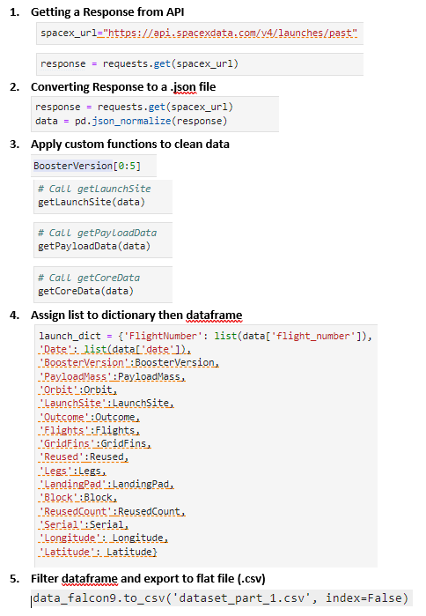
Data Collection – SpaceX API
Launch data is retrieved from SpaceX API
Other supplementary launch data is retrieved from Wikipedia
Add the GitHub URL of the completed SpaceX API calls notebook (must include completed code cell and outcome cell), as an external reference and for peer-review purposes
https://github.com/xxShellxShockxx/IBM-Capstone/blob/main/jupyter-labs-webscraping.ipynb

Slide 9
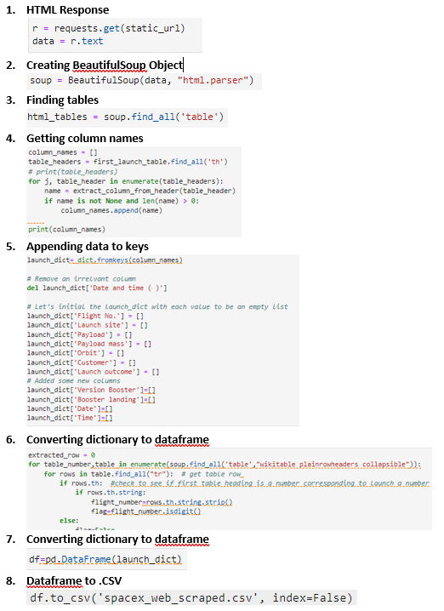
Data Collection - Scraping
Present your web scraping process using key phrases and flowcharts
Add the GitHub URL of the completed web scraping notebook, as an external reference and for peer-review purpose
https://github.com/xxShellxShockxx/IBM-Capstone/blob/main/jupyter-labs-spacex-data-collection-api.ipynb

Slide 10
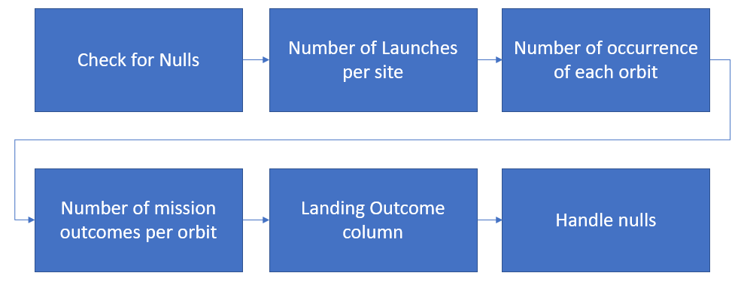
Data Wrangling

Slide 11
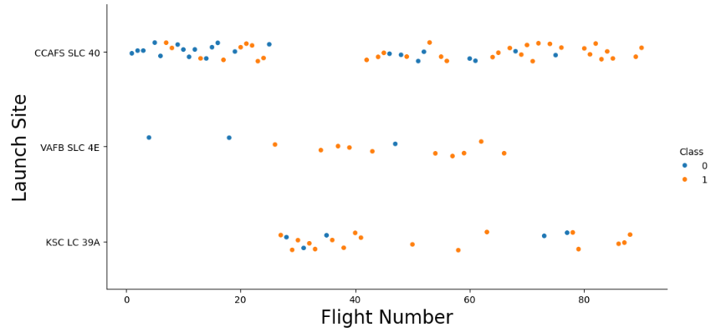
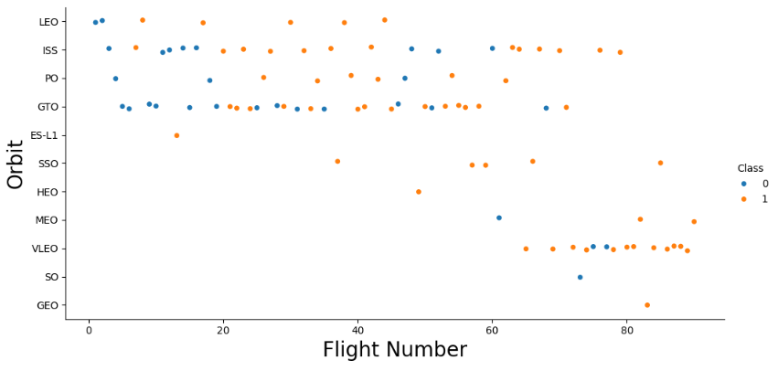
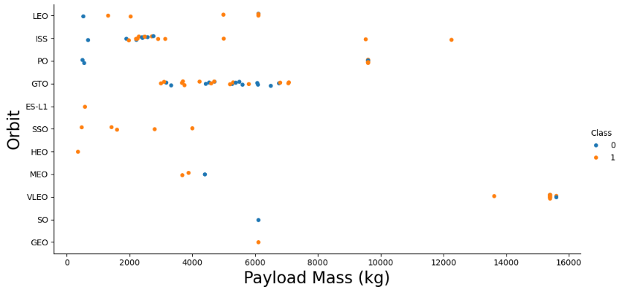
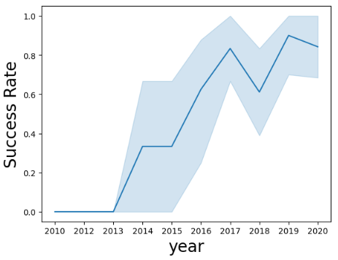
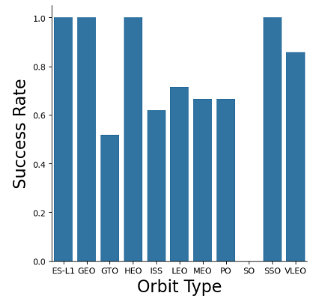
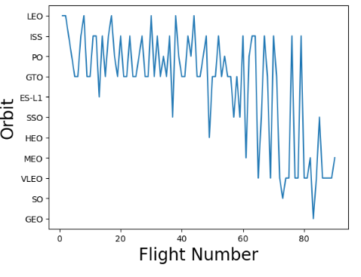
EDA with Data Visualization
https://github.com/xxShellxShockxx/IBM-Capstone/blob/main/jupyter-labs-eda-dataviz.ipynb.jupyterlite.ipynb

Slide 12
EDA with SQL
SQL queries performed include:
Display 5 records where the launch site begins with ‘KSC’.
Display avg payload carried by F9 v1.1
List of dates for successful landing outcome on the drone ship was achieved
List boosters with a payload greater than 4000 but less than 6000 that was successful at ground pad.
List of successful and failure missions.

Slide 13
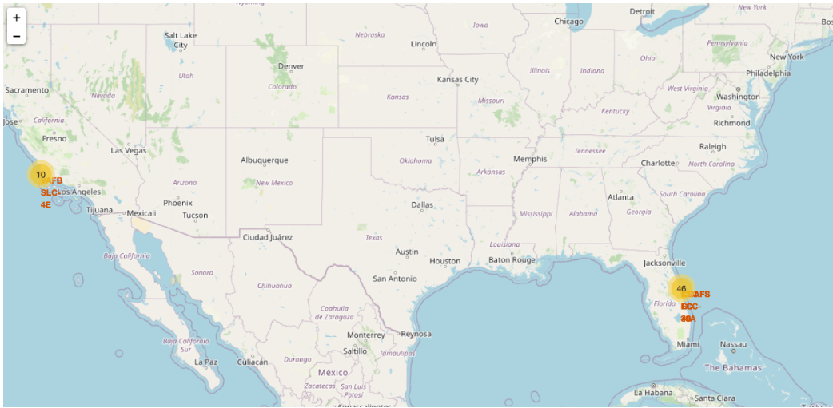
Build an Interactive Map with Folium
Map Markers identify the optimal location for launch sites

Slide 14
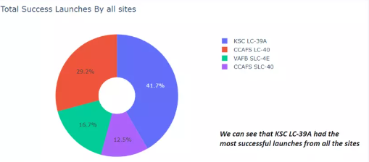
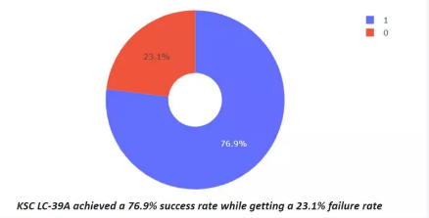
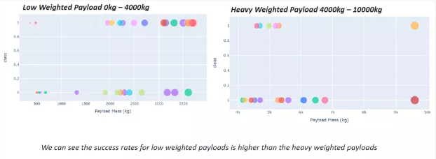
Build a Dashboard with Plotly Dash

Slide 15
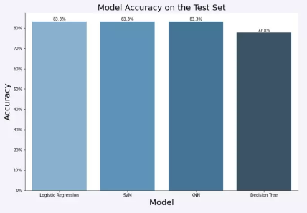
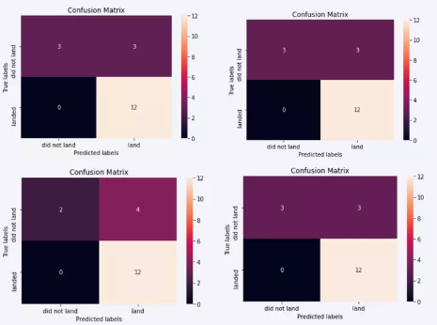
Predictive Analysis (Classification)
LR, SVM, and KNN had the highest accuracy. The SVM model performed at 0.958 in the area under the curve.

Slide 16
Results
LR, SVM, and KNN have the best accuracy.
Low-weight payloads perform the best.
KSC LC 39A had the most successful launches.
Orbit GEO, HEO, SSO, ES L1 have the best success rate.

Slide 17

Section 2

Slide 18
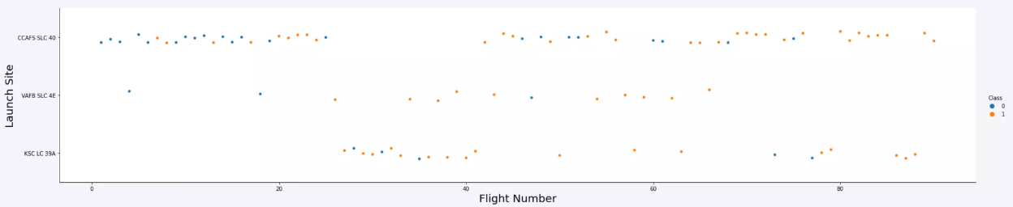
Flight Number vs. Launch Site
CCAFS SLC 40 has significantly more launches

Slide 19
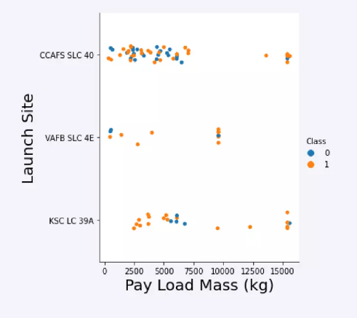
Payload vs. Launch Site
IPay loads with lower mass have been launched from CCAFS SLC 40.

Slide 20
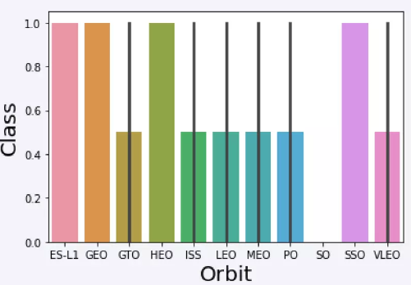
Success Rate vs. Orbit Type
ES-L1, GEO, HEO, and SSO have the highest success rate.

Slide 21
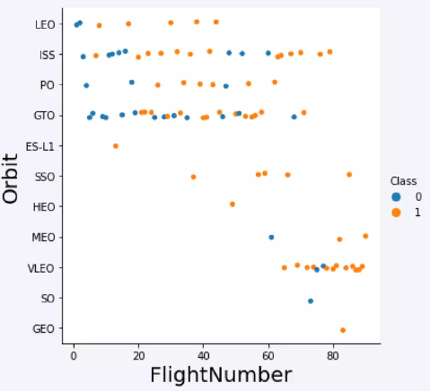
Flight Number vs. Orbit Type
VLEO launches have been shifted to in recent years

Slide 22
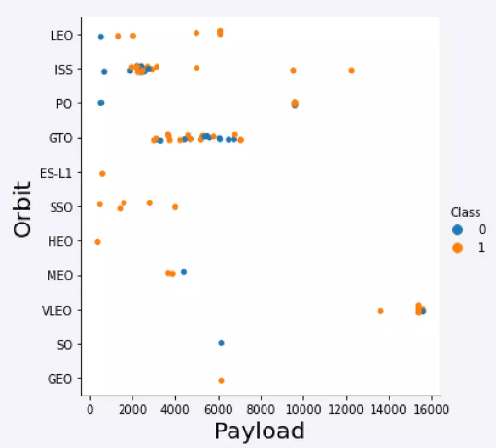
Payload vs. Orbit Type
Strong correlation between ISS and payload at 2000 as well as Gto and the range 4000-8000.

Slide 23
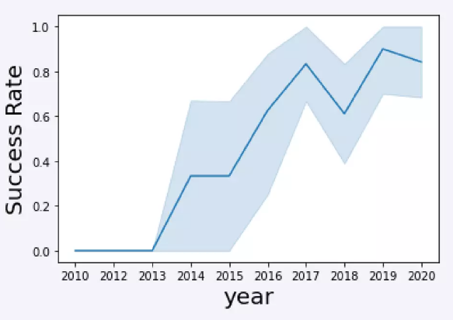
Launch Success Yearly Trend
The launch success rate has stabilized as of 2019 due to advances in technology.

Slide 24
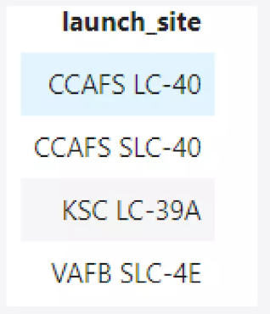
All Launch Site Names
%sql select distinct(LAUNCH_SITE) from SPACEXTBL

Slide 25
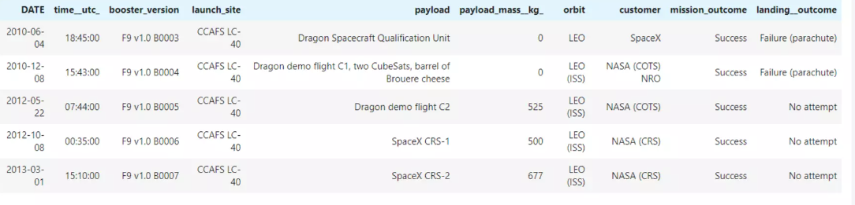
Launch Site Names Begin with 'CCA'
%sql select * from SPACEXTBL where LAUNCH_SITE like ‘CCA%’ limit 5

Slide 26
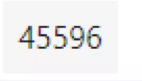
Total Payload Mass
%sql select sum(PAYLOAD_MASS_KG_) from SPACEXTBL where CUSTOMER = ‘NASA (CRS)’

Slide 27
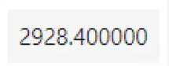
Average Payload Mass by F9 v1.1
%sql select avg(PAYOAD_MASS_KG_) from SPACEXTBL where BOOSTER_VERSION = ‘F9 v1.1’

Slide 28
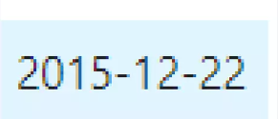
First Successful Ground Landing Date
%sql select min(DATE) from SPACEXTBL where Landing_Outcome = ‘Success (ground pad)’

Slide 29
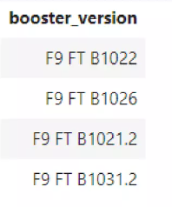
Successful Drone Ship Landing with Payload between 4000 and 6000
%sql select BOOSTER_VERSION from SPACEXTBL where Landing_Outcome = ‘Success(drone ship)’ and PAYLOAD_MASS_KG_> 4000 and PAYLOAD_MASS_KG_ < 6000

Slide 30
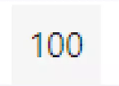
Total Number of Successful and Failure Mission Outcomes
%sql select count(MISSION_OUTCOME) from SPACEXTBL where MISSION_OUTCOME = ‘Success’ or MISSION_OUTCOME = ‘Failure (in flight)’

Slide 31
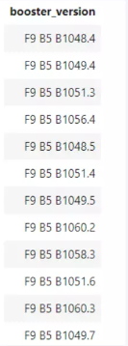
Boosters Carried Maximum Payload
%sql select BOOSTER_VERSION from SPACEXTBL where PAYLOAD_MASS_KG_ = (select max(PAYLOAD_MASS_KG_) from SPACEXTBL)

Slide 32
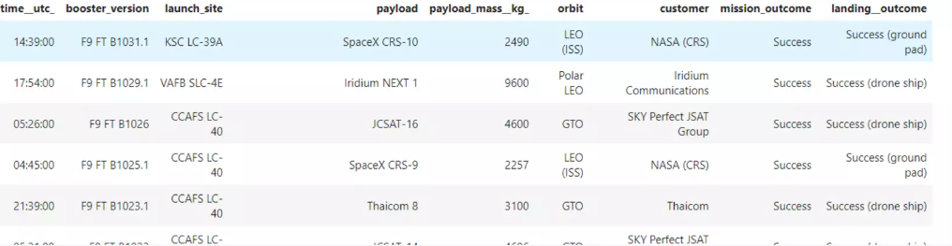
2015 Launch Records
%sql select * from SPACEXTBL where Landing_Outcome like ‘Success%’ and (DATE between ‘2015-01-01’ and ‘2015-12-31’) order by date desc

Slide 33
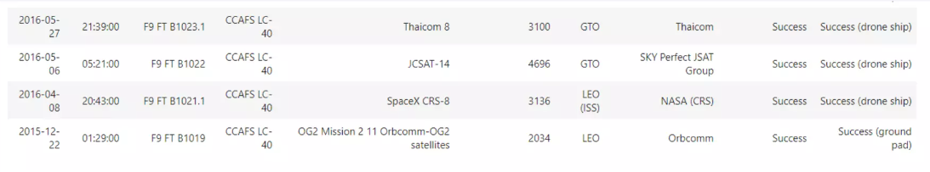
Rank Landing Outcomes Between 2010-06-04 and 2017-03-20
%sql select * from SPCEXTBL where Landing_Outcome like ‘Success%’ and (DATE between ‘2010-06-04’ and ‘2017-03-20’) order by date desc

Slide 34

Section 3

Slide 35
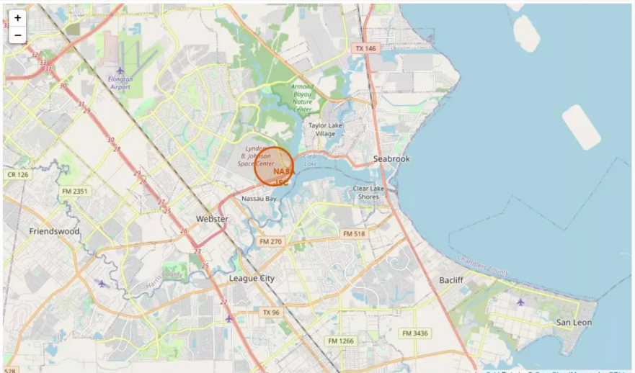
Launch sites marked on map

Slide 36
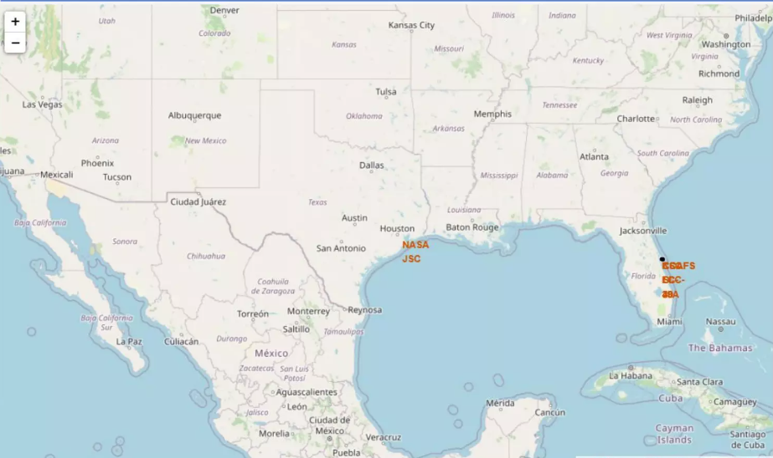
Launches marked on the map

Slide 37
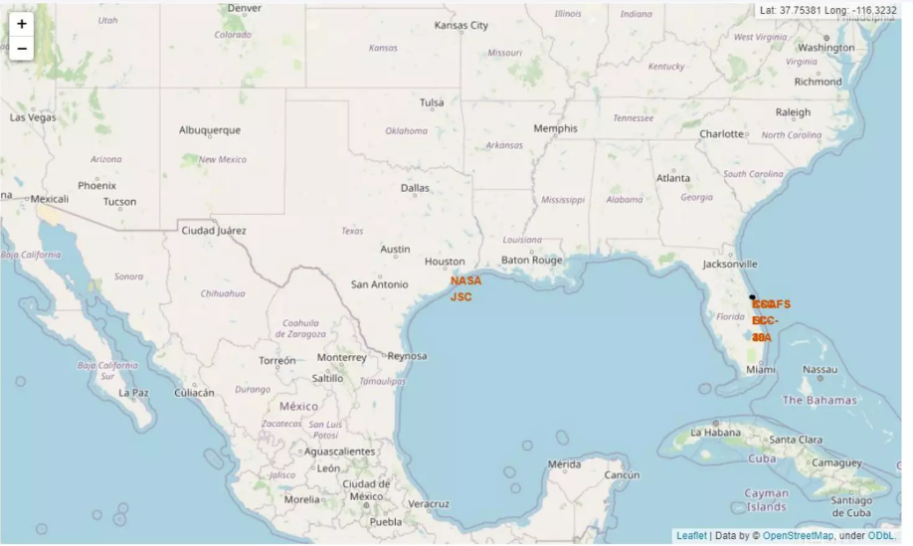
Distance between launch site to its proximities

Slide 38

Section 4

Slide 39

Successful launches by all sites

Slide 40
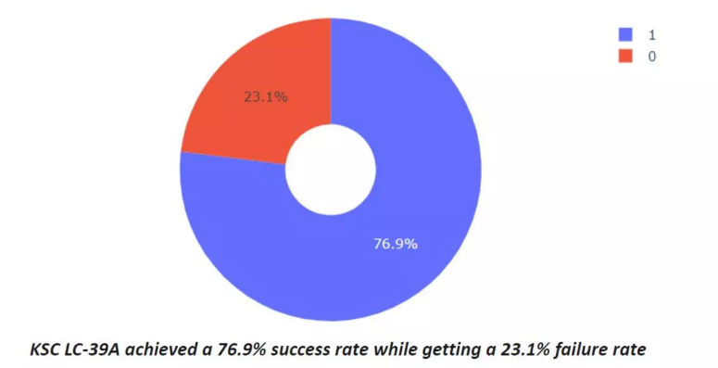
Success rate by site

Slide 41
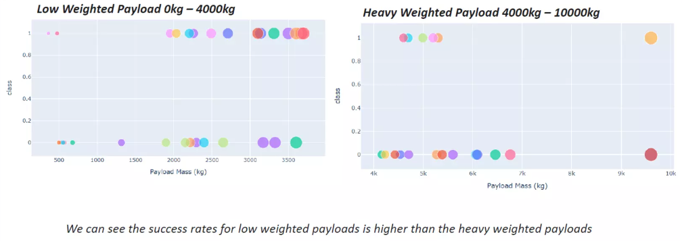
Payload vs launch outcome

Slide 42

Section 5

Slide 43
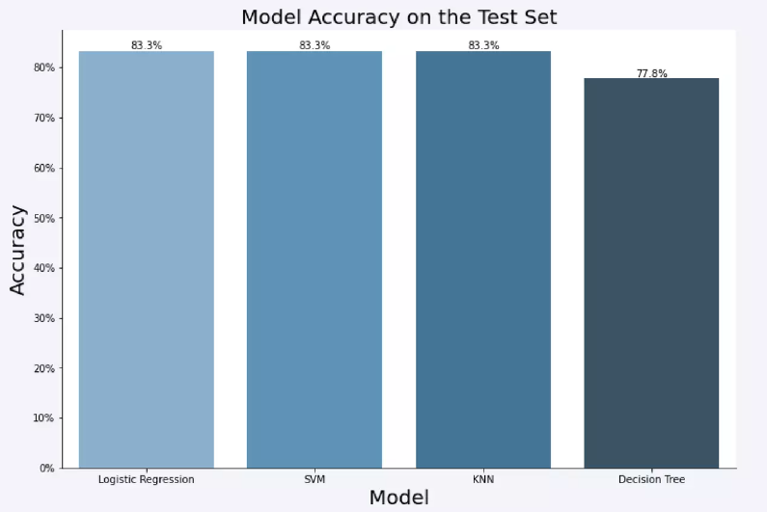
Classification Accuracy

Slide 44
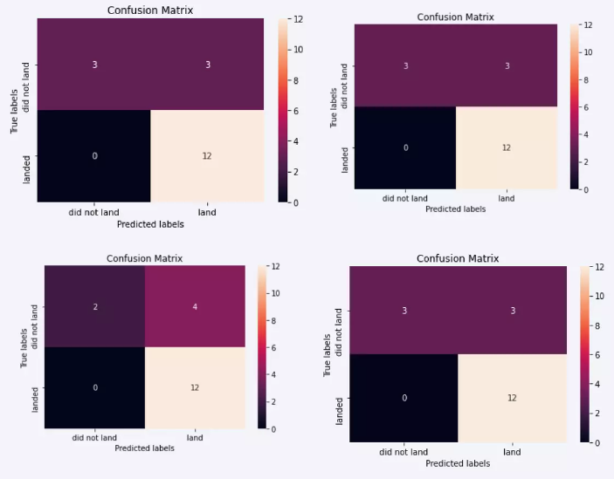
Confusion Matrix

Slide 45
Conclusions
The LG, KNN, and SVM models have the best accuracy.
Low-weighted payloads perform the best
KSC LC 39A had the most success
Orbit GEO, HEO, SSO, ES L1 has the best Success Rate

Slide 46


